Slide 1
Additional Notes
(Re. Logistic Regression discussion)

Slide 2
How to undersample the majority class
[Main concern: do not lose important information]
Random undersampling: Delete some points
Clustering: Replace some points by their cluster centroid
Tomek links: Remove data points whose nearest neighbors are from the other class

Slide 3
How to oversample the minority class
[Main concern: do not introduce spurious information]
Random oversampling: Duplicate some points
Noise augmentation: add small random noise to existing data points
SMOTE: randomly interpolate between two nearby points
ADASYN: similar, but give greater weightage to points that are difficult to learn (e.g., with neighbors from the other class)

Slide 4
Receiver Operating Characteristic (ROC) Curve
A model for binary classification may be used with different possible hyper-parameters, and results may differ with each choice.
Example: for the same neural network trained to minimize MSE, we may interpret results differently based on the output node’s value:
if output < 0.4, say “Class 0” vs.
if output < 0.7, say “Class 0”
How can we evaluate the model (and compare it with another)?
Solution: Plot True Positive Rate against False Positive Rate, for each possible value of the hyperparameter.
Measure Area Under ROC Curve (AUC).

Slide 5
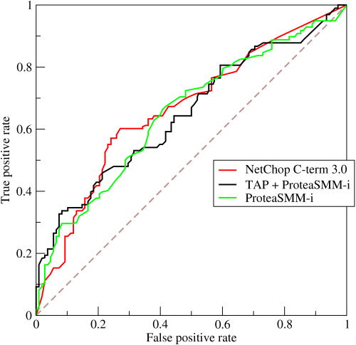
Example ROC curves for three different models
“Higher” (AUC) is better!
Ideal scenario: horizontal line at the top of the graph, for which AUC = 1.
In this example, at some points the green curve is “higher” than than the red curve.
But the red curve has more area under it than the other two, hence its model is preferred.
Alternative when only a few points are available to plot the curves: add up the heights of the bars in a bar chart.
Notes:
From the 3 best models , prof identified the model with highes area under curve.

Slide 6
Maximum Likelihood Estimation
For a chosen model, which set of parameter values is best?
E.g., which set of coefficients for different features, in linear regression?
Find the set of parameter values that maximize ”Likelihood” defined as the probability of generating available data, given specific parameter values.
E.g., we tossed a coin 100 times and got 60 Heads and 40 Tails; is the coin fair? What if we repeat this experiment ten times, getting different numbers each time?
Computation involves multiplying several numbers, e.g., computing the product of the probability of generating each data point.
Often, we instead minimize negative log likelihood, since it’s easier to add than multiply, and it’s easier to work with positive numbers.
For the coin toss scenario, this results in the obvious answer, e.g., the best model is that the coin is unfair, with a 60% probability of Heads.
Reasonable answers that depend on the data are also obtained for other problems, e.g., finding the mean and variance of a Gaussian.

Slide 7
Common Sense Concerns when using regression (and other ML variations)
Do the numbers make sense?
Is the model too big and complicated for the problem (and data)?
Are we making unfounded assumptions?
Prior probabilities
Absence ofIgnoring important external variables because they are unavailable
Unchanging data generation process
feedback loops in data generation
Phase changes leading to drastically different behavior
Behavior in extreme conditions
Susceptibility to random variations in external conditions

